Slide 1
Abiding in Christ

Slide 2
John 15
Abide (10 times)

Slide 3
John 15:5 NKJV
“I am the vine, you are the branches. He who abides in Me, and I in him, bears much fruit; for without Me you can do nothing.

Slide 4
How do you abide? John 13, 14 & 15
Love Jesus Remain Love others

Slide 5
Love Jesus (dependence)
John 14
¹⁵ “If you love me, keep my commands.
²¹ Whoever has my commands and keeps them is the one who loves me.
²³ Jesus replied, “Anyone who loves me will obey my teaching.
²⁴ Anyone who does not love me will not obey my teaching.
^{31 …} I love the Father and do exactly what my Father has commanded me.
John 15
¹⁰ If you keep my commands, you will remain in my love, just as I have kept my Father’s commands and remain in his love.

Slide 6
Abide
John 15
⁴ Remain in me, as I also remain in you. (Quiet time)
⁵ “I am the vine; you are the branches. If you remain in me and I in you, you will bear much fruit…(Jesus gives the fruit)
⁶ If you do not remain in me…thrown away, withered, burned in fire
⁷ If you remain in me and my words remain in you, ask whatever you wish, and it will be done for you. (Scripture memory)
THE RESULT…
⁸ This is to my Father’s glory, that you bear much fruit, showing yourselves to be my disciples.

Slide 7
February 10, 2003
Tom’s Spiritual Family
Cal
Audie
Jeff
Bob S.
Jim
Richard
Ramzi
Tom S.
Alec
John S.
Tom M.
Rett
Dave
Bob B.
Paul
Pete George
Allen
Josh
Joe Coggeshall
Dallas
Rob
Brett
Dave Rathkamp
Tracey
Cory
Tom Sawyer
Andy
Jacob
John S.
Frank
Tom H.
Rene
Dan
Jim
Gary
Ken
Antonio
Bill
Pete
Steve
Al
Bryan
Lou
Brandon
Tom C.
Jody
Sammy
Gerry
Josh
Duffy
George
Ryan

Slide 8
February 22, 2012
Tom Sawyer’s Spiritual Family
Tyler
Bob S.
Cal
Jim
Sami
Xavier
Tom S.
Jim
Audie
John S.
Craig
Jeff
Craig
Bob B.
Alec
Ramzi
Jose
Allen
Joe
Rett
Tom M.
Chin
Dallas
Tracey
Michael
Andy
Frank
Jason
Pete George
Dan
Xavier
Tom L.
Henry
Joe Coggeshall
Gary
Paul
Ken
Tom C.
Kirk
Chad
Les
Josh
Dave Rathkamp
Bryan
Rob
Brett
Scott
Bill
Stan
Radkey
Tom Sawyer
Al
Brandon
Billy
Lou
Josh L.
Cory
Roy
Sammy
Duffy
Mike
Jacob
Andy
John S.
Mark
Scott
Gerry
Ryan
Rene
Jim
Chris
Steve
George
David
Antonio
Pete
Dale
Jeff
Jody

Slide 9
Tom Sawyer’s Spiritual Family
January 31, 2019
Brandt
Van
Jeremiah
Spence
Kenny
Mason
Mike
Cody
Randy
Joseph
Jim
Mike
Guevara
Andrew
Tyler
Bob S.
Jim
Gabriel
Kevin
Cal
Tom S.
Michael
Aniel
Sami
Xavier
Jim
Audie
Jeff
Travis
John S.
Brad
Craig
Jose
Bob B.
Joe
Corbin
Alec
Ramzi
Allen
Tracey
Rett
Tom M.
Chin
Dallas
Jason
Bob
Michael
Andy
Frank
Jason
Pete George
Henry
Dan
Justin
Xavier
Tom L.
Joe Coggeshall
Gary
Kirk
Craig
Paul
Ken
Tom C.
Pete
Phil
Josh
Chad
Dave Rathkamp
Les
Richard
Bob
Jason
Bill
Bryan
Bob H.
Rob
Brett
Tom Sawyer
Scott
Brandon
Billy
Richard
Stan
Radkey
Al
Josh L.
Robert
Cory
Sammy
Lou
Roy
Mike
Jacob
John S.
Scott
Tom
Gerry
Duffy
Andy
Mark
Ryan
Rene
Jim
Chris
Brad
Antonio
Steve
George
David
Pete
Dale
Jeff
Jeff
-Multiple reproduction (red)
-Surrogate Timothies (green)
Salty
Scott
Jody
Chin
Mark
Pat
David
John
Eric
Jason
Steven
Mark

Slide 10
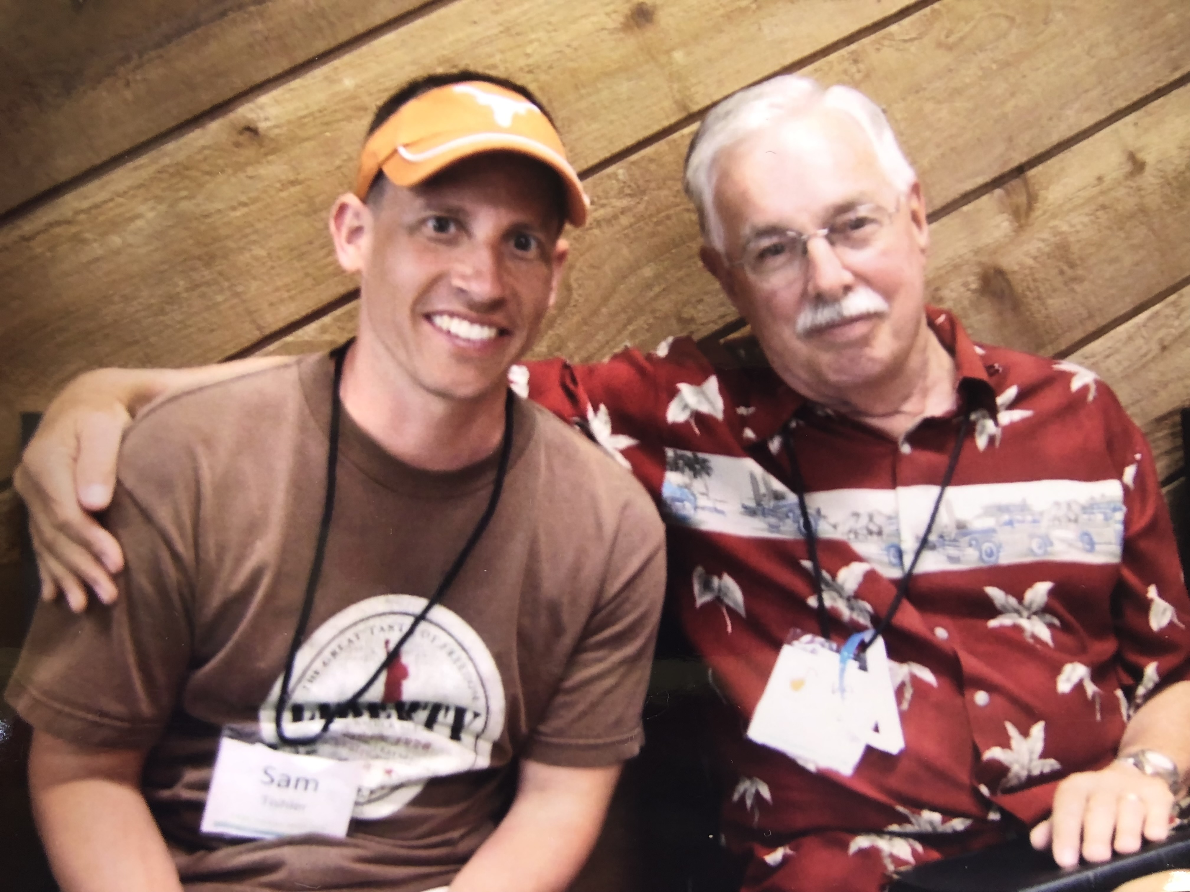
Love others
John
13 ³⁴ “A new command I give you: Love one another. As I have loved you, so you must love one another. ³⁵ By this everyone will know that you are my disciples, if you love one another.”
15 ¹² My command is this: Love each other as I have loved you.
15 ¹⁷ This is my command: Love each other.

Slide 11
The Spirit & Abiding
How do we know if we are abiding?
1 John 4:13 This is how we know that we live in him and he in us: He has given us of his Spirit.
1 John 3:24 The one who keeps God’s commands lives in him, and he in them. And this is how we know that he lives in us: We know it by the Spirit he gave us.

Slide 12
The Spirit & Abiding
Flesh vs. Spirit (Romans 8 and Galatians 5)
Romans 8:5 Those who live according to the flesh have their minds set on what the flesh desires; but those who live in accordance with the Spirit have their minds set on what the Spirit desires.
Galations 5:16 walk by the Spirit (not flesh) Galatians 5:18 be led by the Spirit (not flesh)
Ephesians 4:30 do not grieve the Spirit Ephesians 5:18 be filled with the Spirit
1 Thessalonians 5:19 do not quench the Spirit

Slide 13
“I was doing it all wrong; I was chasing fruit when I should have been abiding!”
If we major on fruit bearing, we run the risk of not abiding. If we major on abiding, the fruit will follow.
Walt Henrichsen

Slide 14
